Slide 1
Talk Details : Software Development, Cooking and Driving - An Allegory

Slide 2
"Programming is a craft, an art form. Programmers are part listener, part advisor, part interpreter, and part dictator."
Source : The pragmatic programmer by Andrew Hunt, David Thomas

Slide 3
The Four/Five Stages of Learning
Unconscious Incompetence - I don’t know what I don’t know
Conscious Incompetence - I now know about it, but not good at it. Ignorance is no longer bliss. Learner is aware of the skill that they lack and can understand that there is a deficit
Conscious Competence - I know how, but need to think and concentrate about what I need to do. When a learner has acquired a skill but has not yet mastered it to the point where it comes naturally
Unconscious Competence - I know and I can do it effortlessly. Habitual and Automatic
Notes:
https://www.kdplatform.com/four-stages-learning/

Slide 4
Conscious competence of unconscious competence
(Flow/Mastery) – Guru. Learner is able to relate to learners in stages 1-4 enough to teach them. A stage five learner has reached a point where they can reflect on how they reached their level of mastery. This means that they can empathize with learners in other stages. In your organization, your super volunteers or SMEs are the most likely to be “fifth stagers.” They can be useful in mentoring new members or providing guidance.

Slide 5
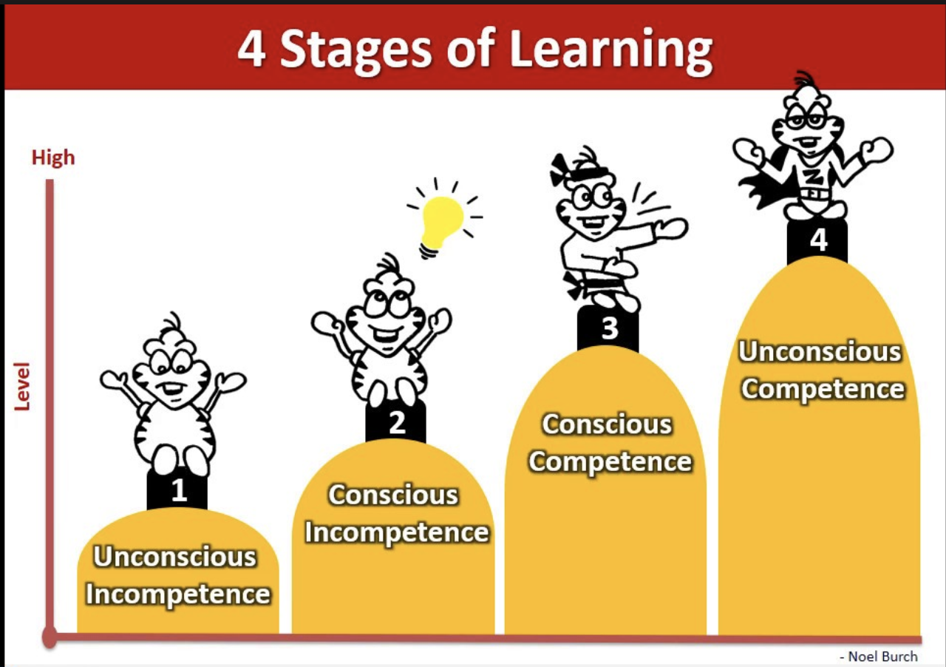

Slide 6
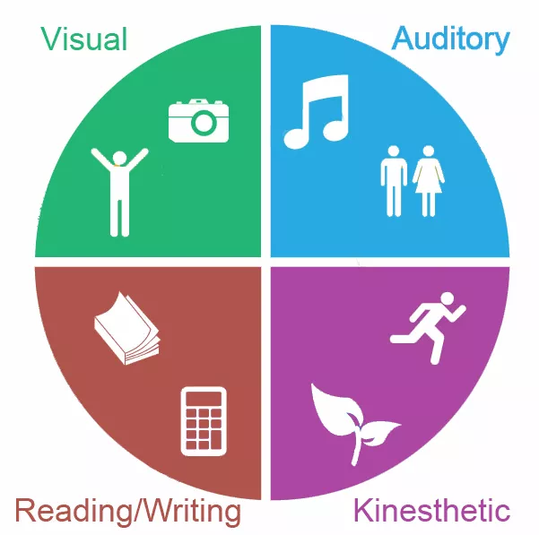

Slide 7
Types of Learners
Visual or Spatial - Almost everything having to do with computers is conceptual and so it relies on graphical or visual representations of components that can’t actually be seen
Auditory - Good listeners
Reading/Writing - Uses Annotations
Kinesthetic or Tactile - Practical,Hands on
The linguistic learner is one who learns best through linguistic skills including reading, writing, listening, or speaking.
The linguistic learner is one who learns best through linguistic skills including reading, writing, listening, or speaking.
Notes:
The linguistic learner The linguistic learner is one who learns best through linguistic skills including reading, writing, listening, or speaking.is one who learns best through linguistic skills including reading, writing, listening, or speaking.

Slide 8
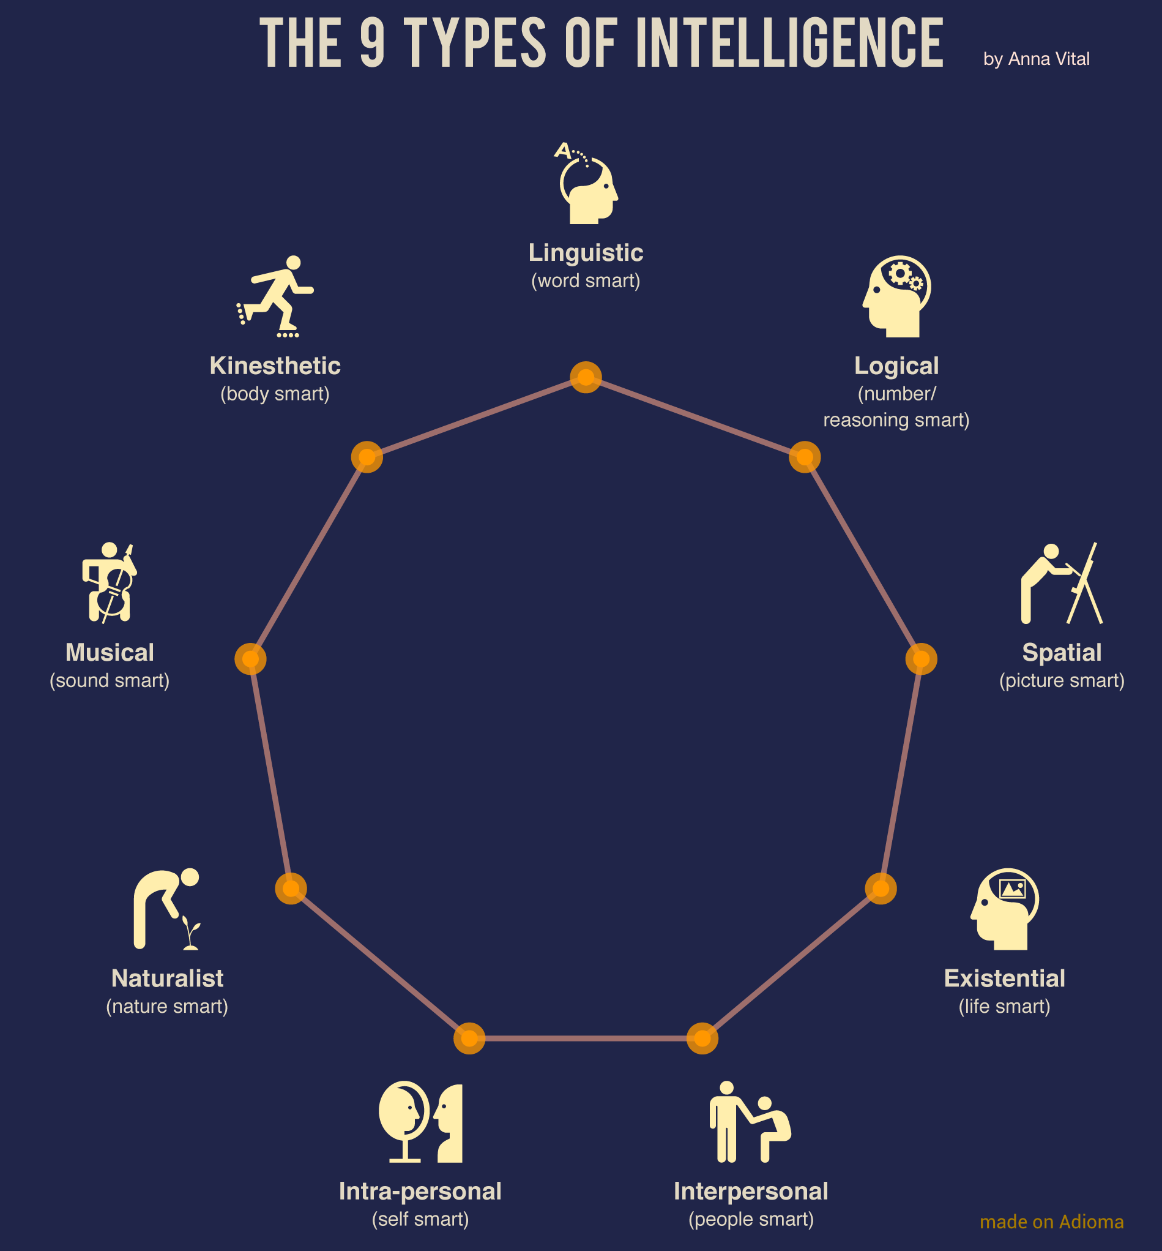
The 8 Learning Styles - Fine Tune

Slide 9
Factors affecting learning
Internal
Motivation, beliefs and values, prior knowledge, cultural identity, life experiences, attitude, age, emotional, physical and mental state.
External
Lighting, seats, group size, duration of instruction, noise, gender consideration, temperature, and air circulation.

Slide 10
This and That?
Rote Learning : Memorizing formulas, list, facts, using mnemonics
Gestalt Learning : Progressive approach to learning that entails understanding a concept or activity. Learning through recognizing or making connections between previously established principles. It is an essential factor in the development of road craft.

Slide 11

Ice Breaker
Hamburger Feedback : 3 step method of constructive criticism
Treat the car brakes like marshmallows
Schadenfreude /ˈSHädənˌfroidə/

Slide 12


Slide 13
Mise en place \ ˌmē-ˌzäⁿ-ˈpläs\ (French for “everything in its place”) is a cooking technique in which the cook prepares their ingredients before starting the work of combining them to create the dish.

Slide 14
Clean as you go!
Cooking and coding are similar - make you gain weight mysteriously, lose hours of time and be strangely pleased about the accomplishment of finishing until you see the mess you have to go back and clean up.
Be creative, Have an open mind, anticipate frustrations
Get basics right, have the right tools or skill set
Ability to multitask eventually

Slide 15
Thank you!

